Slide 1
Phillip
Kevin Lane
Kotler • Keller
Marketing Management • 14e

Slide 2

Defining Marketing for the 21st Century
Chapter 1

Slide 3

Discussion Questions
Why is marketing important?
What is the scope of marketing?
What are some fundamental marketing concepts?
How has marketing management changed in recent years?
What are the task necessary for successful marketing management?

Slide 4
Marketing
Demand
Revenue
Jobs
Profits
Giving
Notes:
Marketing creates demand for a product, which in turn drives revenue. Greater demand creates the need for companies to hire new workers, while revenue (top line) contributes to a company’s bottom line (profits), which allow the company to be more fully engaged in socially responsible activities.

Slide 5

Marketing is the activity, set of institutions, and processes for creating, communicating, delivering, and exchanging offers that have value for customers, clients, partners, and society at large.

Slide 6

Marketing management is the art and science of choosing target markets and getting, keeping, and growing customers through creating, delivering, and communicating superior customer value.

Slide 7
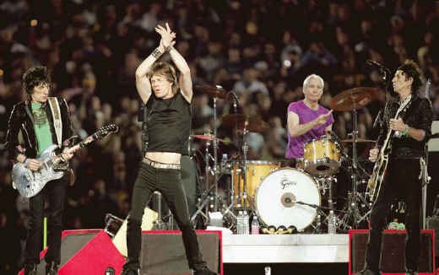



What is Marketed?
Persons
Experiences
Events
Properties
Organizations
Information
Ideas
Goods
Places
Services
Notes:
Experiences include a trip to Disney World, Fantasy baseball camp, a cruise.
Events can include trade shows, the Olympics, Super Bowl, etc.
Properties include real estate as well as stocks and bonds.
Organizations use marketing to connect with their target market.
Information is marketed by universities, textbook publishers, newspapers, etc.
Ideas include “Friends don’t let friends drive drunk”

Slide 8


Who markets?
Response
Attention
Purchase
Donation
Vote
Marketer
Prospect
Notes:
Marketers are individuals, groups, associations, companies, etc. that seek a response, such as attention, a purchase, donation, vote, etc., from another party which is called the prospect.

Slide 9



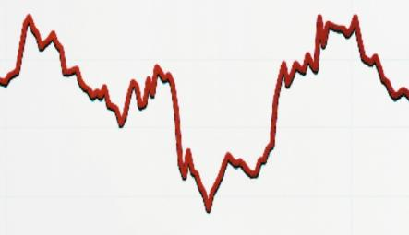
Types of Demand
Unwholesome
Declining
Nonexistent
Latent
Full
Overfull
Irregular
Negative
Notes:
Negative – consumer’s dislike a product and may pay to avoid, such as with dental work
Nonexistent – consumers are unaware of or uninterested in the product or service
Latent – There is no product on the market that can satisfy consumer needs
Declining – Consumers purchase a product less and less frequently, or not at all. For example, the sale of albums (vinyl and CD’s) are declining significantly.
Irregular – A products demand varies by time, such as on a seasonal basis.
Full – Consumers are buying all the products that enter into the market.
Overfull – There are more buyers than product available.
Unwholesome – Consumers are attracted to products that have undesireable social consequences, such as cigarettes or gambling.

Slide 10
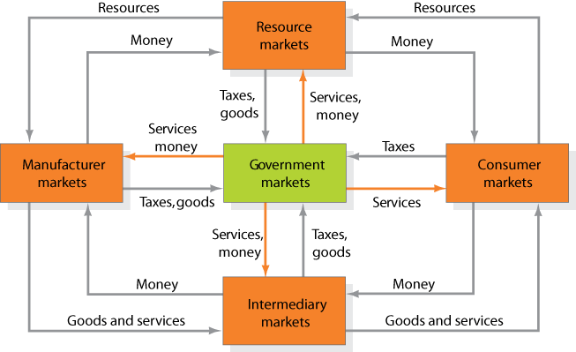
Markets
Figure 1.1
Notes:
Economist describe a market as a collection of buyers and sellers who transact over a particular product or product class.
There are five basic markets – Manufacturer, resource (financial, labor, raw materials), intermediary (wholesalers, resellers, etc), consumer, and government.

Slide 11
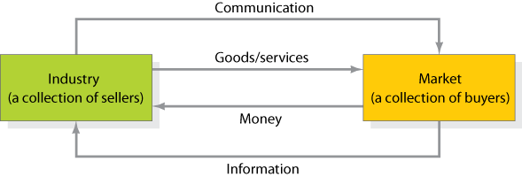
Simple Marketing System
Figure 1.2

Slide 12



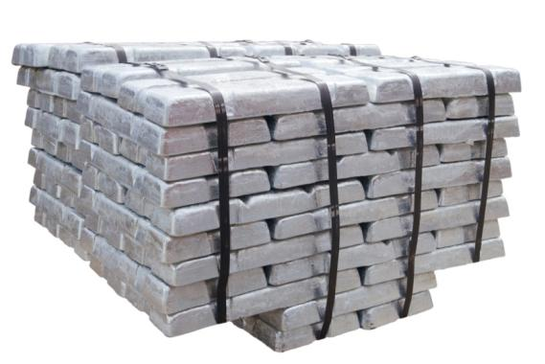

Key Customer Markets
Global Markets
Consumer Market
Business Markets
Government Market

Slide 13



Markets
Marketplaces
Marketspaces
Metamarkets
Notes:
Marketplace – physical locations (such as retail store)
Marketspace – digital location (online retailer)
Metamarkets – The cluster of complementary products and services related in consumers mind, but spread across diverse set of industries.

Slide 14




Core Marketing Concepts
Target Markets, Positioning, and Segmentation
Needs, Wants, and Demands
Offerings and Brands
Value and Satisfaction
Notes:
The intangible value proposition is made physical by an offering, which can be a combination of product, services, information and experiences.
A brand is an offering from a known source.
The buyer chooses the offerings he or she perceives to deliverthemostvalue

Slide 15


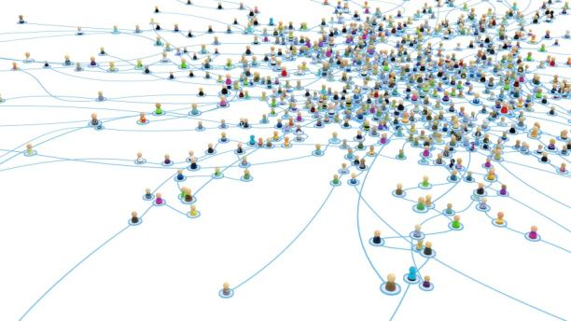

Core Marketing Concepts
Marketing Channels
Supply Chain
Marketing Environment
Competition
Notes:
Three marketing channels: communication, distribution and service channel.
Two types marketing environment: Task and broad environment
Broad environment: demograhic, economic, socio-cultural, natural, technological, political-legal

Slide 16
The New Marketing Realities
Globalization
Communicate w/Customer
Information Technology
Collect Information
Major Societal Forces
New Company Capabilities
Consumer Information
Differentiate Goods
Increased Competition
Notes:
Major societal forces, such as information technologies, globalization, increased competition, and a more informed consumer have altered the marketplace has changed significantly. While these have created challenges, organizations have responded with new capabilities

Slide 17

Who is Responsible for Marketing?
Entire Organization
Marketing Department
Chief Marketing Officer
(CMO)
Notes:
CMOs must have strong quantitative skills, to accompany their qualitative skills. Must be entrepreneurial as well as a team player. However, the CMO nor the marketing department can be solely responsible for marketing. It must be undertaken by the entire organization.
David Packard of Hewlett-Packard is quoted as saying: “Marketing is far to important to be left to the marketing department.”

Slide 18




Marketing Concepts
Quality
Innovation
Create, deliver, and communicate value
Production
Product
Selling
Marketing
Holistic
Mass production
Mass distribution
Unsought goods
Overcapacity
Notes:
The five distinct marketing concepts are: Production, Product, Selling, Marketing, and Holistic. These philosophies have evolved over time and began with the production concept. The evolution of a new marketing concept does not mean that all companies are changing. Many companies continue to operate under the production concept.
Under a production philosophy the company will seek to mass produce products and to distribute them on a wide scale. The belief is that consumers prefer products that are widely available and inexpensive.
The product concept proposes that consumers prefer products that have higher quality, performance, or are more innovative. Often, managers focus too much on the product (a better mousetrap) but this does not always equal success.
The selling concept argues that members of a market will not purchase enough product on their own so companies use the “hard-sell” to increase demand. Typically used with unsought goods such as insurance or cemetery plots, or when companies face overcapacity.
The marketing concept first emerged in the 1950’s and focuses more on the customer with a “sense-and-respond” attitude. Companies that have embraced the marketing concept have been shown to achieve superior performance than competitors.
The holistic concept takes a philosophy that everything matters in marketing. Figure 1.3 (next slide) outlines the Holistic Marketing Concept.

Slide 19
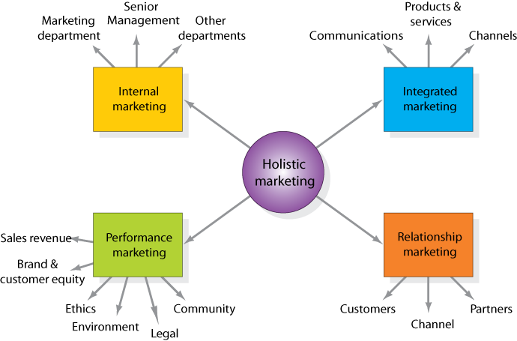
Holistic Marketing Dimensions
Figure 1.3

Slide 20


Relationship Marketing
Build long-term relationships
Develop marketing networks
Notes:
Relationship marketing seeks to build mutually beneficial, long-term relationship with key constituents in order to earn and retain their business. The four key constituents are: customers, employees, partners, and member of the financial community. Attracting a new customer can cost five times as much as retaining existing customers so building long-term relationships makes financial sense for the company.
Marketing networks consist of the company and its supporting stakeholders who have built a mutually profitable business relationship.

Slide 21

Integrated Marketing
Create, communicate, and deliver customer value
Notes:
Integrated marketing holds that all activities undertaken by the company should create, communicate, and deliver value. Further, all new activities should take into consideration all other marketing activities.

Slide 22

Internal Marketing
Notes:
Internal marketing is the task of hiring, training, and motivating able employees to serve customers well. You can’t promise excellent service if you can’t deliver excellent service.

Slide 23



Performance Marketing
Social Responsibility
Financial Accountability
Notes:
Marketers must understand both the financial and nonfinancial returns to a business and society from marketing programs and activities. Financial accountability involves the justification of marketing expenditures in terms of financial returns. But they must also think about the ethical, environmental, legal, and social aspects of their activities.

Slide 24
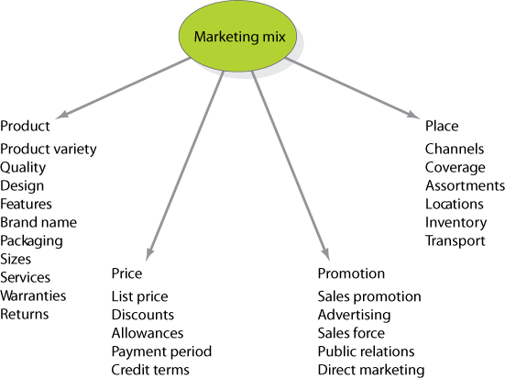
The Four P’s of the Marketing Mix
Figure 1.4

Slide 25
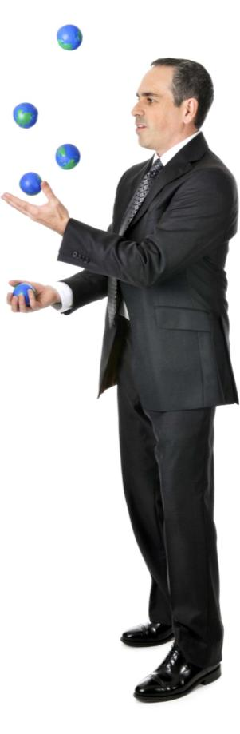
Marketing Management Tasks
Developing market strategies and plans
Capturing marketing insights
Connecting with customers
Building strong brands
Shaping market offerings
Delivering value
Communicating value
Creating long-term growth

